Slide 1




Solid Hands-on in Solidity
Sriram
Technology of Trust

Slide 2

Course Objectives
After completing this module, you should be able to:
Solidity Programming and Implementation
Crowd Funding
Implementing Dapp

Slide 3


Solid Hands-on in Solidity

Slide 4


Introduction to Solidity
Introduction
High-level programming language, that is used to implement smart contracts
Designed to compile the code for Ethereum Virtual Machine
Remix - browser-based IDE provides an inbuilt compiler as a well as run-time environment without server-side components
Version Pragma
Version pragma specifies what versions of Solidity a source file can work on
To choose the versions of compilers pragma solidity ^0.4.0;
Pragma ensures that the source code is only meant for compiler versions that are not older than >= 0.4.0 and <0.5.0
Comments
Single-line comments
//
Multi-line comments
/*...*/

Slide 5
Introduction to Solidity..
Doxygen type comments
Provides a confirmation text which is shown to users when they attempt to invoke a function.
pragma solidity ^0.4.0;
/** @title Shape calculator. */ contract ShapeCalculator {
/** @dev Calculates a rectangle's surface and perimeter.
@param w Width of the rectangle.
@param h Height of the rectangle.
@return s The calculated surface.
@return p The calculated perimeter.
*/
function rectangle(uint w, uint h) public pure returns (uint s, uint p) { s = w * h;
p = 2 * (w + h);
}
}

Slide 6
Introduction to Solidity..
Imports
Importing in Solidity uses statements that very similar to Java import "importedFile";
import "./x"
Contract Structure
Similar to classes in object-oriented programming languages
Contracts in Solidity can inherit elements from other contracts.
Every contract contains declarations of elements such as functions, function modifiers, state variables, struct and enum types, events as needed for its purpose.
State Variables
Permanently stored in contract storage. pragma solidity ^0.4.0;
contract SimpleStorage {
uint storedData; // State variable
// ...
}

Slide 7

Variable Types

Slide 8
Variable Types
Boolean
To store “True” or “False”
bool b = true
Operators
! (logical negation)
&& (logical conjunction, “and”)
|| (logical disjunction, “or”)
• == (equality)
!= (inequality)
Note:-
The operators || and && apply the common short-circuiting rules.
In the expression f(x) || g(y), if f(x) evaluates to true, g(y) will not be evaluated even if it may have side-effects.

Slide 9
Variable Types
Integers
Signed and unsigned integers of various sizes.
Keywords uint8 to uint256 in steps of 8 (unsigned of 8 up to 256 bits) and int8 to int256.
“uint and int” are aliases for uint256 and int256, respectively.
Operators:
Comparisons: <=, <, ==, !=, >=, > (evaluate to bool)
Bit operators: &, |, ^ (bitwise exclusive or), ~ (bitwise negation)
Arithmetic operators: +, -, unary -,
unary +, *, /, % (remainder), ** (exponentiation), << (left shift), >> (right shift)
The operators || and && apply the common short-circuiting rules. This means that in the expression f(x) || g(y), if f(x) evaluates to true, g(y) will not be evaluated even if it may have side-effects.

Slide 10
Variable Types
Address
Holds a 20 byte value (size of an Ethereum address).
Address types also have members and serve as a base for all contracts
Members of Addresses
Balance and Transfer
Fixed-Size byte arrays
Fixed size byte arrays are declared using the keyword byteX, the X being any number from 1 to 32.
The keyword byte is an alias for byte1.
It is possible to query the balance of an address using the property balance and to send Ether to an address using the transfer function:
address x = 0x123; address myAddress = this;
if (x.balance < 10 && myAddress.balance >= 10){ x.transfer(10);
}
Operators
<=, <, ==, !=, >= and >
Address can be a
Contract address
Wallet address
Comparison operators (evaluates to bool)
<= – less than or equal
< – less than
== – equal to
!= – not equal to
>= – greater than or equal
> – greater than
Bit operators
& – bitwise AND
| – bitwise inclusive OR
^ – bitwise XOR
(exclusive OR)
~ – bitwise NOT
<< – left shift
>> – right shift
Index access
In case x is type bytesI, it means
that x[k] for 0 <= k < I will return kth byte, which is read-only.

Slide 11
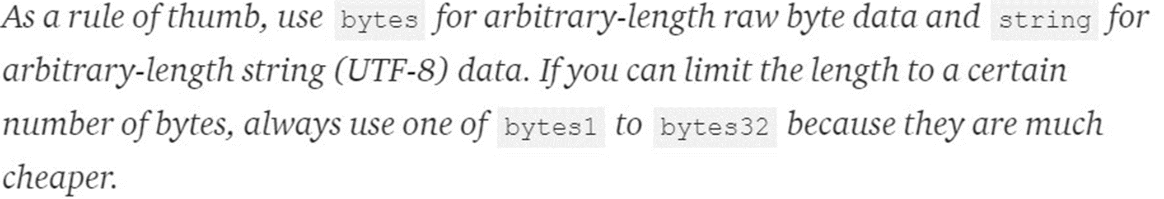
Variable Types
Fixed Size Byte Array
bytes1, bytes2, bytes3, …, bytes32. byte is an alias for bytes1.
Index access: If x is of type bytes and I is the length, then x[k] for 0 <= k < I returns the k th byte (read-only).
Members
.length yields the fixed length of the byte array (read-only).
Dynamic Size Byte Array
bytes - declares an array with a dynamic size, not a value type.
string - declares UTF-8 encoded string with dynamic size, not a value type either.

Slide 12
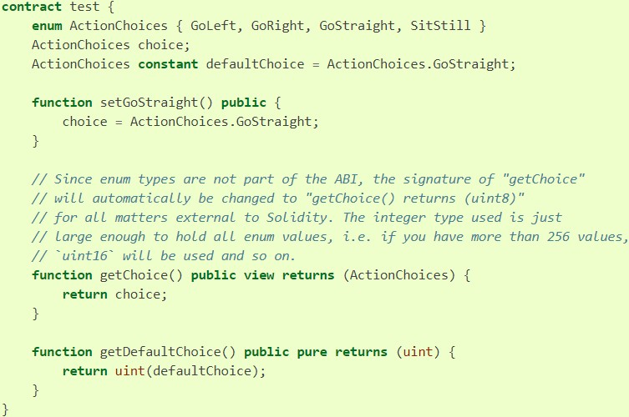
Variable Types
Enum is declared with the keyword enum
To create a user-defined type in Solidity

Slide 13
Variable Types
Struct
Structs are custom defined types that can group several variables
struct Funder { address addr; uint amount;
}
mapping (uint => Funder) funders;
funders [idx] = Funder(msg.sender, msg.value) ;

Slide 14




Variable Types - Summary
First and the most common value type is uint.
uint stores the data in 256 bits or 32 byte. Due to being unsigned it can store a very large number 2^256-1 (zero needs one space).
Used for
Currency value and amount as there is not float or double
Storing Unix timestamp as it store a very large number
uint x;
Initializing
uint x = 45;
int is a signed integer whose size is same like uint which is 256 bits
2^256 / 2 - 1
Can create constant variable
For int and uint, size can be explicitly set in steps of 8 up to 256 for example int8, int16, int24
uint8 b; int64 c; uint248 ;
Int n=1;
int constant a = 8; int256 constant b = 8;

Slide 15
Variable Types
Typecasting
int x = int(b);
b will be type casted into int type and then stored in x
bool b = true; is similar to var a = true;
when you declare a variable using the var keyword then the variable's type will be defined by the first value which will be stored in it
Bytes are also available from 1-32 in size
byte a; // byte is same as bytes1 bytes2 b;
bytes32 c;
Dynamically sized bytes can also be declared like this
bytes m
it is actually a special array, same as byte[] array (but packed tightly)

Slide 16
Variable Types
Arrays
Static array whose length is 5 fixed bytes32[5] nicknames;
Dynamic array whose length can be changed at any time can be specified like this
bytes32[] names;
Add a new element using push function which returns new length of the array like this uint newLength = names.push("John");
String
String is same as bytes, but string does not allow length or index
access as of today.
// this is how string is defined string n = "hello";
// here string is stored in UTF8, note double quotes, not single

Slide 17
Event Logging
Watch for an important event and log it using “emit” keyword
pragma solidity ^0.4.21;
contract Counter {
uint256 public count = 0;
event Increment(address who); // declaring event function increment() public {
emit Increment(msg.sender); // logging event
count += 1;
}
}
event Increment(address who)
Declares a contract-level event that takes a single parameter of
type address which indicates what address performed the increment operation.
emit Increment(msg.sender)
Logs the previously declared event with msg.sender as its argument.
By convention, event names begin with uppercase letters. This distinguishes them from functions.

Slide 18
Crowd Funding

Slide 19

CROWD FUNDING

Slide 20

Crowd Funding Demonstration
To demonstrate
Variables Types
Structs
Emit
Transaction for contract creation – Check the source code in the contract address
Contract address : 0x6ea3F0370bF640995b76964cA75e3338a3f7d699
https://ropsten.etherscan.io/tx/0x80d149523a3f9f2972742d4b618c81c60544a7670baf5f0870d36c905bf9c580

Slide 21
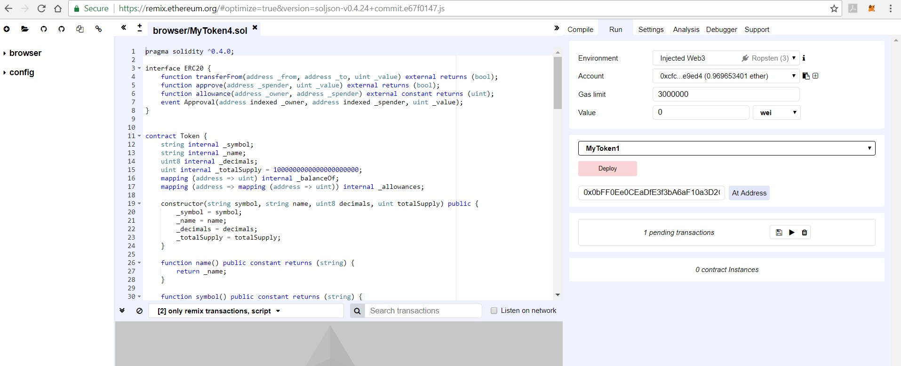
Remix
Web browser based IDE
To write Solidity smart contracts,
To deploy and
To run the smart contract.
Good for debugging - step through the contract which is extremely helpful Visit: https://remix.ethereum.org

Slide 22


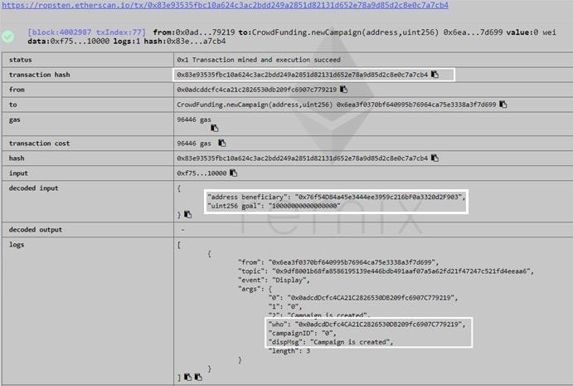
Demonstration
https://ropsten.etherscan.io/tx/0x83e93535fbc10a624c3ac2bdd249a2851d82131d652e78a9d85d2c8e0c7a7cb4
Create Campaign ID “0” with the goal .01 ETH
Note
Transaction Hash
Logs

Slide 23


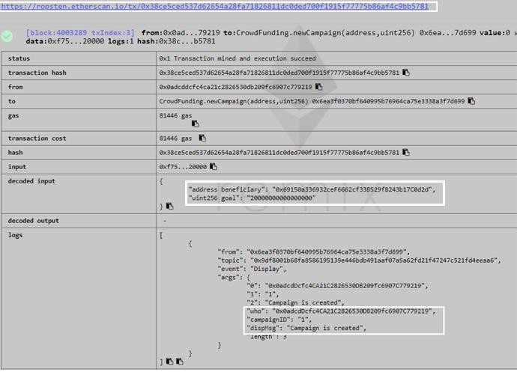
Demonstration
https://ropsten.etherscan.io/tx/0x38ce5ced537d62654a28fa71826811dc0ded700f1915f77775b86af4c9bb5781
Create Campaign ID “1” with the goal .02 ETH
Note
Transaction Hash
Logs

Slide 24

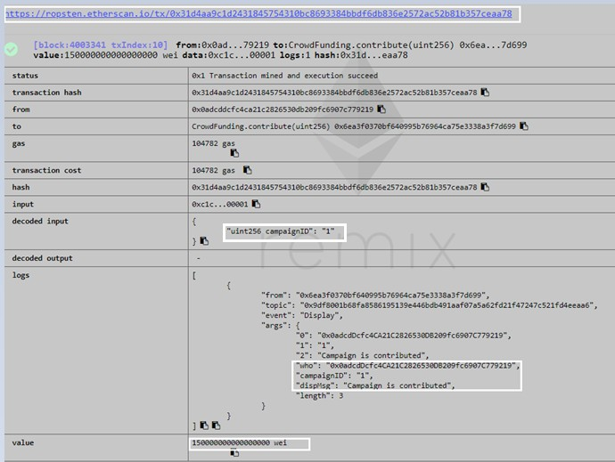

Demonstration
https://ropsten.etherscan.io/tx/0x31d4aa9c1d2431845754310bc8693384bbdf6db836e2572ac52b81b357ceaa78
Contribute .15 Ether to the Campaign ID “1”
Note:
Transaction Hash
Logs
Value

Slide 25

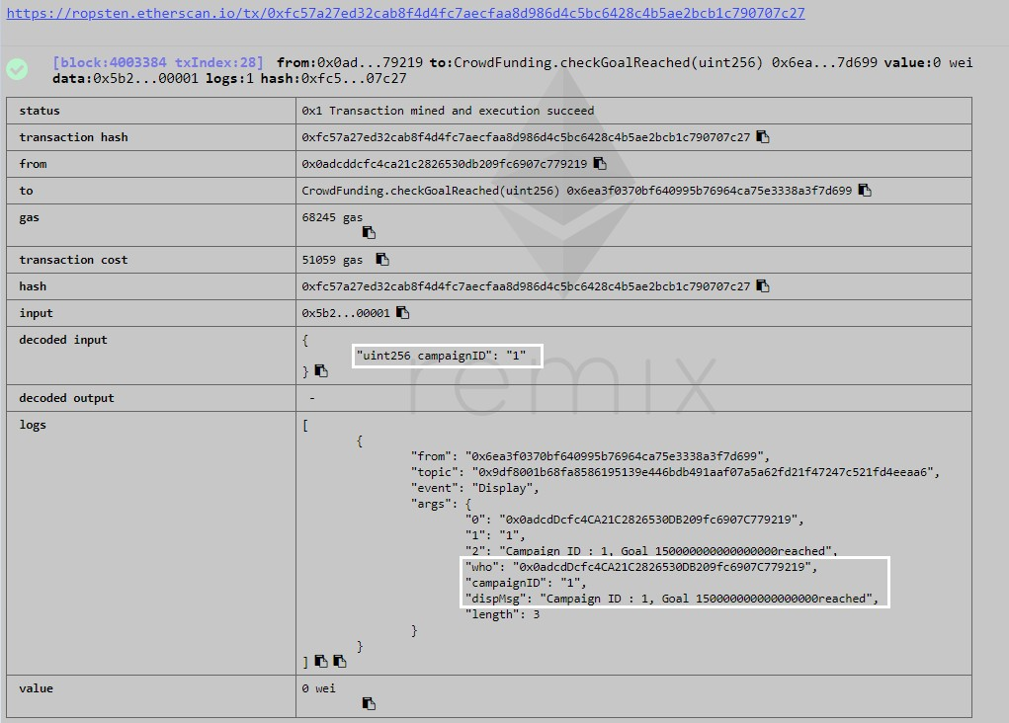
Demonstration
https://ropsten.etherscan.io/tx/0xfc57a27ed32cab8f4d4fc7aecfaa8d986d4c5bc6428c4b5ae2bcb1c790707c27
Check if camp ID “1” goal is reached
Note
Transaction Hash
Logs
Value

Slide 26
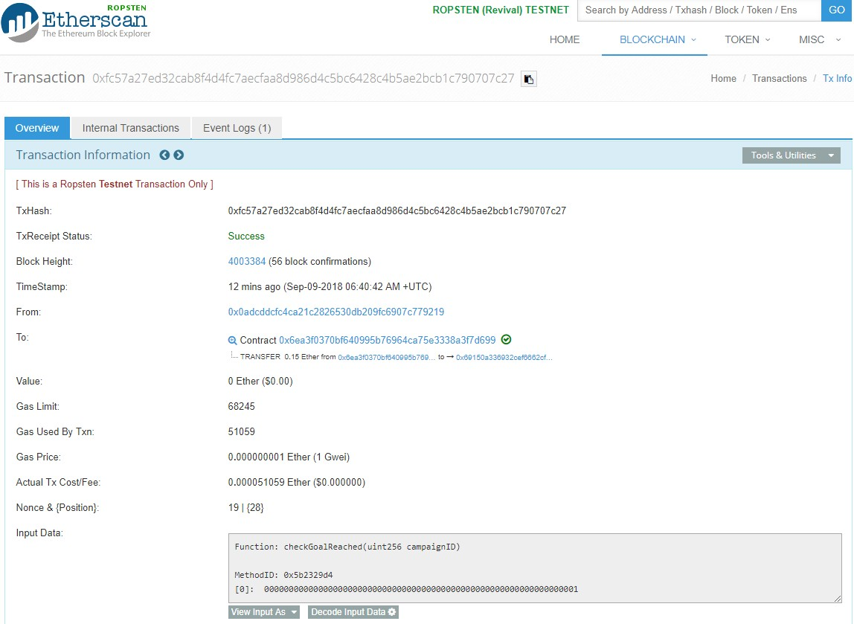
Demonstration
https://ropsten.etherscan.io/tx/0xfc57a27ed32cab8f4d4fc7aecfaa8d986d4c5bc6428c4b5ae2bcb1c790707c27

Slide 27
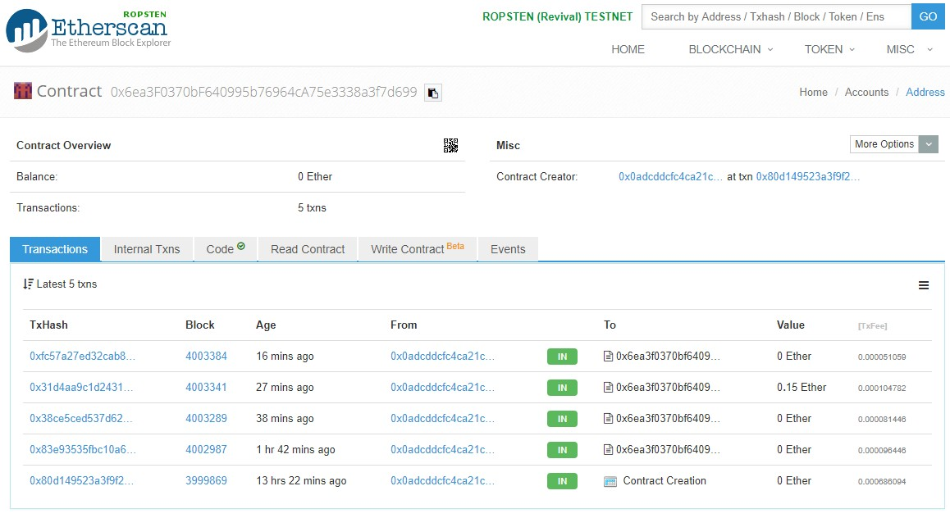
Demonstration

Slide 28
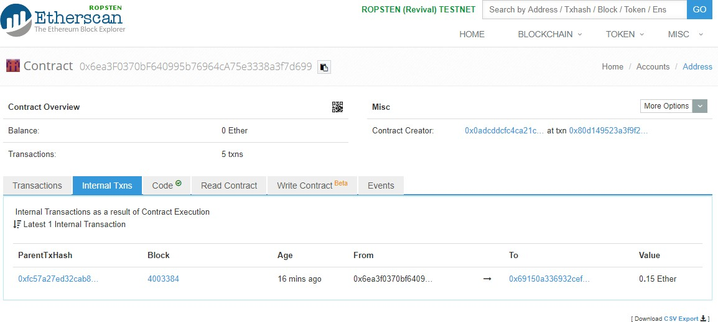
Demonstration

Slide 29
Functions

Slide 30
Functions

Slide 31
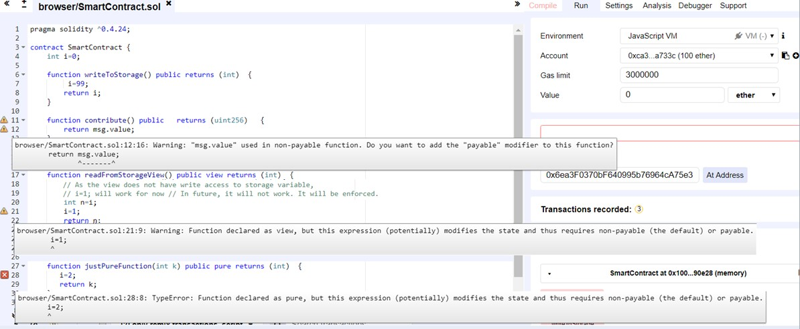
Functions
function (<parameter types>) {internal|external} [pure|view|payable] [returns (<return types>)]
Pure – doesn’t read or write to storage
View – Reads from storage but doesn’t write
Payable – to access the value (Ethers) in a function
Public - all can access
External - Cannot be accessed internally, only externally
Internal - only this contract and contracts deriving from it can access
Private - can be accessed only from this contract
https://ropsten.etherscan.io/address/0x31f0980dde6e7b708dd3efdb20ca2dd505c04f80#code

Slide 32
SelfDestruct

Slide 33
Self Destruct

Slide 34

Self Destruct
The only possibility that code is removed from the Blockchain is when a contract at that address performs
the SELFDESTRUCT operation
The remaining Ether stored at that address is sent to a designated target(Contract creator Address) and then the storage and code is removed.
selfdestruct(owner);
What is happening after a self destruct is called for?
Code and storage associated with it is removed from the Ethereum World State.
Transaction after that point will behave as if the address were an external owned account, i.e., transaction will be accepted, no processing will be done and the transaction status will be success.
Transactions will do nothing, but you still have to pay the transaction fee.
You can even transfer ether, it will be locked forever or until someone finds one of the private keys associated with that address.

Slide 35
FallBack Functions
Function Modifiers
Function Overloading

Slide 36
FallBack Functions

Slide 37

FallBack Functions
Functions which doesn’t have a name or parameter
There’s no going back after a smart contract is deployed
Properties
Fallback functions in Solidity are executed in 2 cases
Unnamed functions
No Arguments
Wont return anything
Only 1 such function Per contract
A function identifier does not match any of the available functions
If there is no data supplied at all

Slide 38
FallBack Functions
contract FuncConcert {
uint constant price = .1 ether; address public owner;
uint public tickets;
mapping (address => uint ) public purchasers;
constructor (uint t) public payable { owner = msg.sender;
tickets = t;
}
// ------------------- FallBack Function --------------------------
function () public payable { buyTickets(1);
}
// ------------------- FallBack Function --------------------------
function buyTickets(uint reqTkts) public payable {
require (msg.value == (reqTkts * price) && reqTkts <= tickets); purchasers[msg.sender] += reqTkts;
tickets-= reqTkts; if (tickets ==0 ) {
selfdestruct(owner);
}
}

Slide 39
Function Modifiers

Slide 40
Function Modifiers
To change the behaviour of functions based on a condition prior to executing the function
contract FunctionModifiers { address public creator; constructor FunctionModifiers() {
// Initialize state variables here creator = msg.sender;
}
//this is how we define the modifiers
modifier onlyCreator() {
// if a condition is not met then throw an exception require(msg.sender == creator) ;
// or else just continue executing the function
_;
}
// this is how we add a modifier to the function
// there can be zero of more number of modifiers function kill() onlyCreator {
selfdestruct(creator);
}
}

Slide 41
Function Overloading

Slide 42
Function Overloading
Functions with same name but with different arguments
pragma solidity ^0.4.16; contract A {
function f(uint _in) public pure returns (uint out) { out = 1;
}
function f(uint _in, bytes32 _key) public pure returns (uint out) { out = 2;
}
}

Slide 43
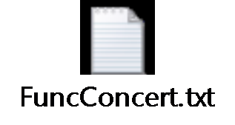

Demonstration
To demonstrate
FallBack Function
Function Modifiers
Function Overloading
SelfDestruct
Create a contract “FuncContract” to understand below concepts
FallBack Function
Buy a ticket in fallback function
Function Overloading
Buy a ticket using buyTickets(uint reqTkts) public payable
Buy a ticket using buyTickets(uint reqTkts,uint freeTickets) public payable
Function Modifier
modifier onlyCreator()
Transaction for contract creation – Check the source code in the contract address
Contract address : 0x797D07772682D2442699E0f2B89B1aF051951202
https://ropsten.etherscan.io/address/0x797d07772682d2442699e0f2b89b1af051951202

Slide 44
Inheritance

Slide 45
Inheritance

Slide 46
Inheritance
Constructors
Solidity supports multiple inheritance by copying code including polymorphism.
All function calls are virtual, which means that the most derived function is called, except when the contract name is explicitly given .When a contract inherits from multiple contracts, only a single contract is created on the blockchain, and the code from all the base contracts is copied into the created contract.
The general inheritance system is very similar to Python’s, especially concerning multiple inheritance.
pragma solidity ^0.4.0;
contract Rose is Flower("Rose"){ function pick() public pure returns
(string){
return "Ouch...";
}
}
contract Flower { address owner; string flowerType;
constructor(string newFlowerType)
public{
owner = msg.sender; flowerType = newFlowerType;
}
function water() public pure returns (string){
return "Aww thanks, I love water!";
}
}
contract Jasmine is Flower("Jasmine"){ function smell() public pure returns
(string){
return "Mmmmm, smells good";
}
}

Slide 47
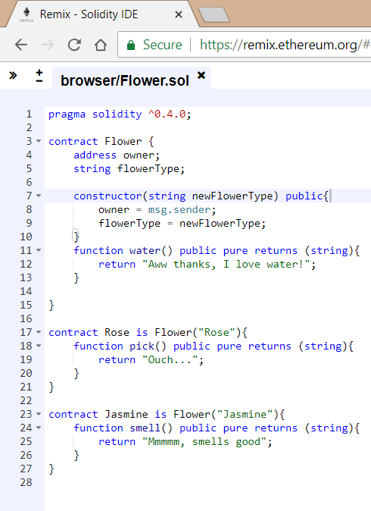
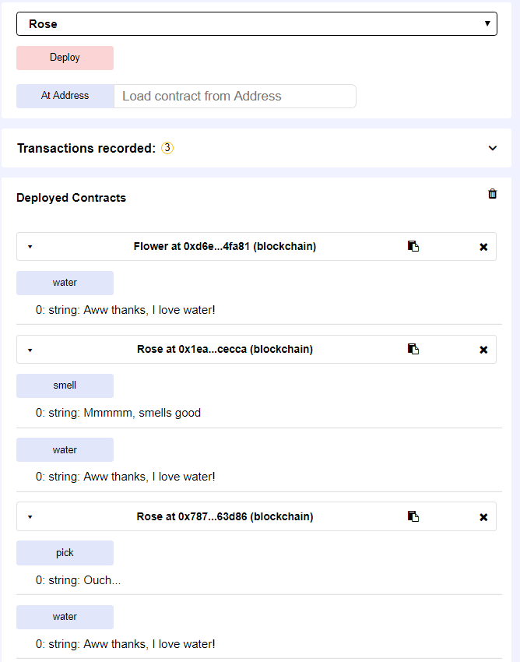
Inheritance

Slide 48
Libraries

Slide 49
Library

Slide 50
Library
Library.sol
pragma solidity ^0.4.0; library IntExtended {
function increment(uint _self) public pure returns (uint) { return _self+1;
}
function decrement(uint _self) public pure returns (uint) { return _self-1;
}
function incrementByValue(uint _self, uint _value) public pure returns (uint) { return _self + _value;
}
function decrementByValue(uint _self, uint _value)public pure returns (uint) { return _self - _value;
}
}

Slide 51
Library
pragma solidity ^0.4.0; import "browser/Library.sol"; contract TestLibrary {
using IntExtended for uint;
function testIncrement1(uint _base) public pure returns (uint) { return IntExtended.increment(_base);
}
// Apply the library to the uint type instead. Note that you don't need to supply the number as the first argument to such a function since it will default to the object you're calling the method on
function testIncrement2(uint _base) public pure returns (uint) { return _base.increment();
}
function testDecrement(uint _base) public pure returns (uint) { return IntExtended.decrement(_base);
}
function testIncrementByValue(uint _base, uint _value) public pure returns (uint) { return _base.incrementByValue(_value);
}
function testDecrementByValue(uint _base, uint _value) public pure returns (uint) {
return _base.decrementByValue(_value);
}
}

Slide 52
Implementing Dapp

Slide 53
Implementing Dapp

Slide 54
Implement Dapp
Create your coin
Implement and deploy your first Dapp in testnet
Development Framework
Truffle
Ganache
IDE – Atom
Different use cases for implementation of Dapp

Slide 55
Remix
Web browser based IDE
To write Solidity smart contracts,
To deploy and
To run the smart contract.
Good for debugging - step through the contract which is extremely helpful https://remix.ethereum.org

Slide 56
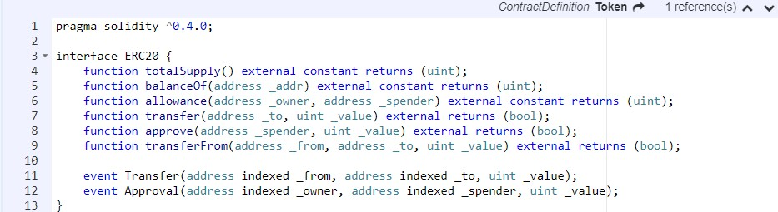
Create your Coin
ERC20 (Ethereum Request for Comments, 20 is proposal ID)
ERC20 is a technical standard used for smart contracts on the Ethereum blockchain for implementing tokens
Contract Address
0x68585c4553B58FF628468a082D5A041377057ba7
https://ropsten.etherscan.io/address/0x68585c4553b58ff628468a082d5a041377057ba7#code

Slide 57
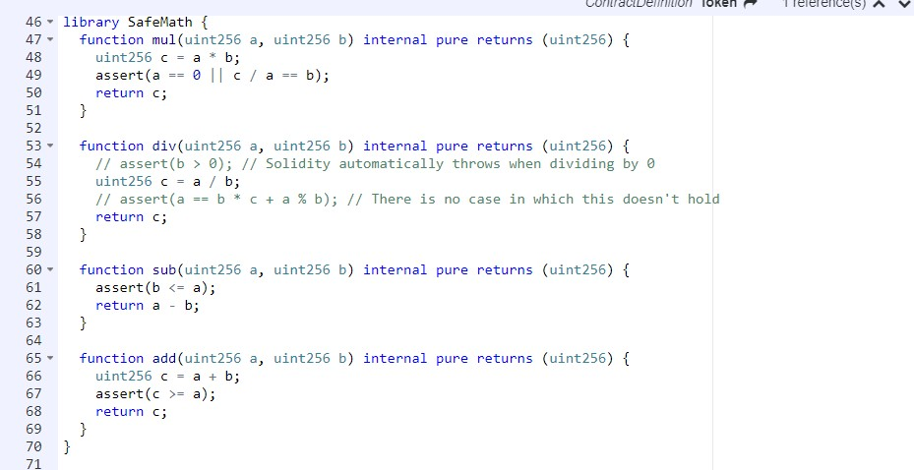
Create your Coin
github.com/OpenZeppelin/zeppelin-solidity/contracts/math/SafeMath.sol
Avoid error due to overflow.
E.g.,While adding 2power256 + 2power256.

Slide 58
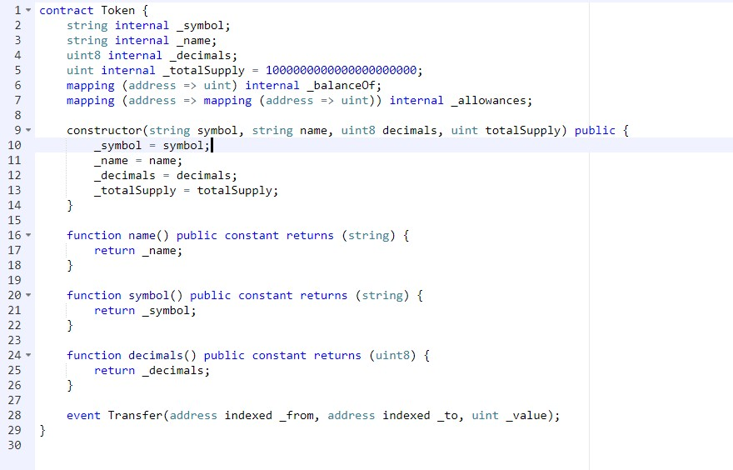
Create your Coin

Slide 59
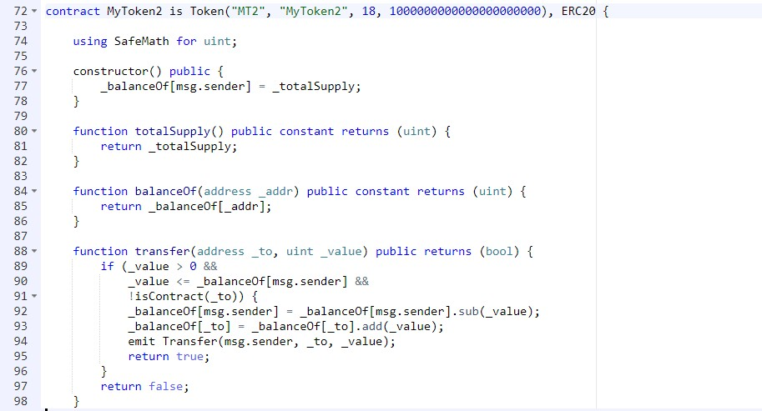
Create your Coin

Slide 60
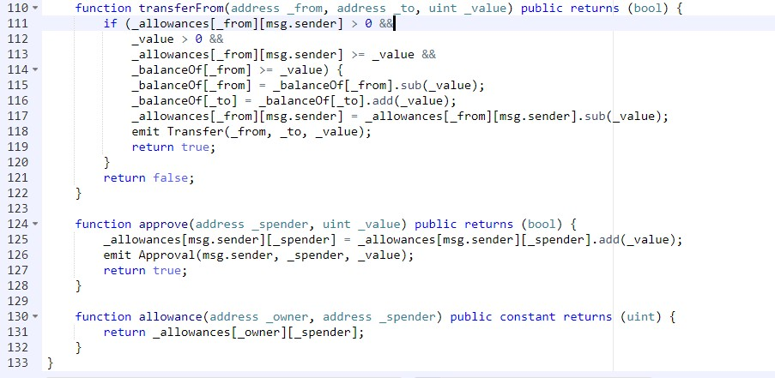
Create your Coin

Slide 61
Truffle Framework

Slide 62
Truffle Framework

Slide 63

Truffle Framework
What is truffle ?
Install
Development environment with testing framework
Interactive console for direct contract communication.
Instant rebuilding of assets during development.
Make sure you have latest Node js and NPM and execute the below command in windows power shell
$ npm install -g truffle
Commands
Website
http://truffleframework.com/
Create a contract
truffle init
Git
https://github.com/trufflesuite/truffle
Command to compile
truffle compile
Command to migrate
truffle migrate

Slide 64
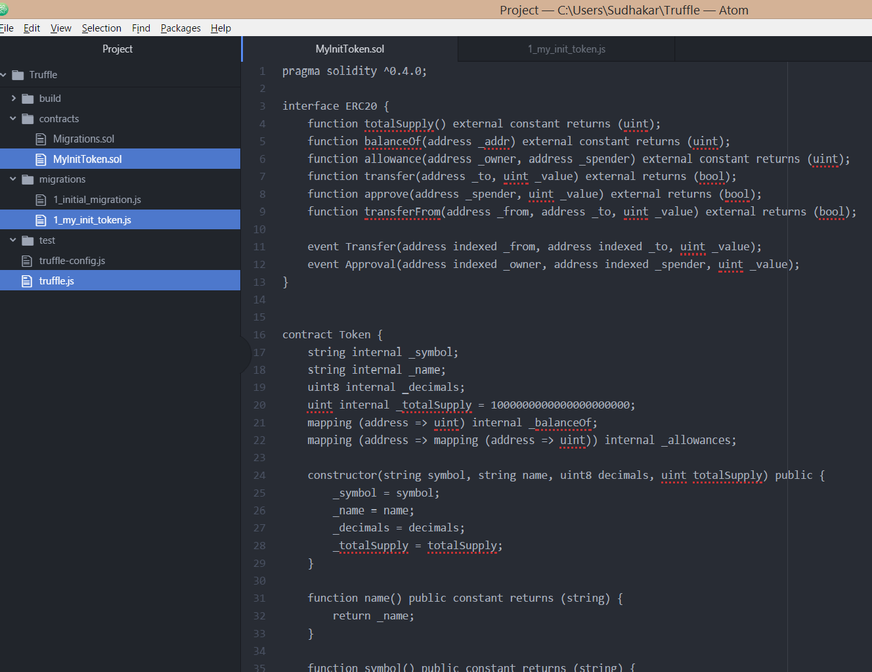

Slide 65
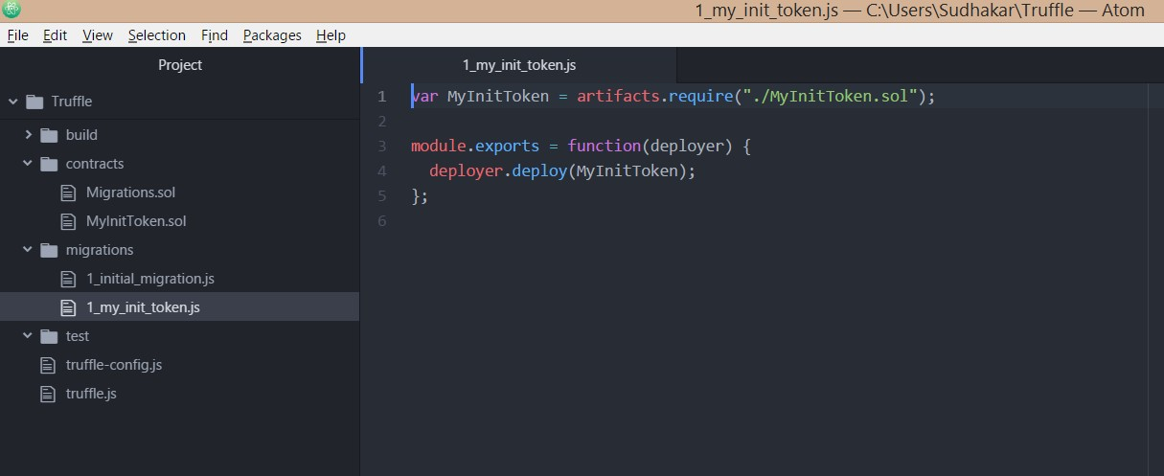
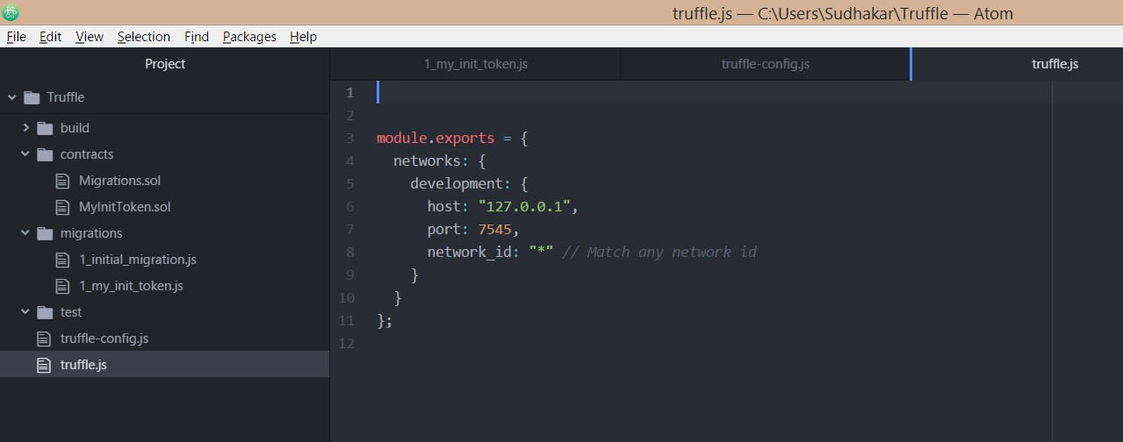

Slide 66
Ganache – Test Framework

Slide 67
Ganache –
Test Blockchain Network

Slide 68

Ganache – Test Blockchain Network
What is Ganache ?
Personal Ethereum blockchain which you can use to
Install (ganache-setup-1.1.0.exe)
https://github.com/trufflesuite/ganache/releases
Pick the latest exe and run it
Run tests
Execute commands
Inspect state while controlling how the chain operates.
Built-in block explorer
Website
http://truffleframework.com/ganache/
Git
https://github.com/trufflesuite/ganache/releases

Slide 69
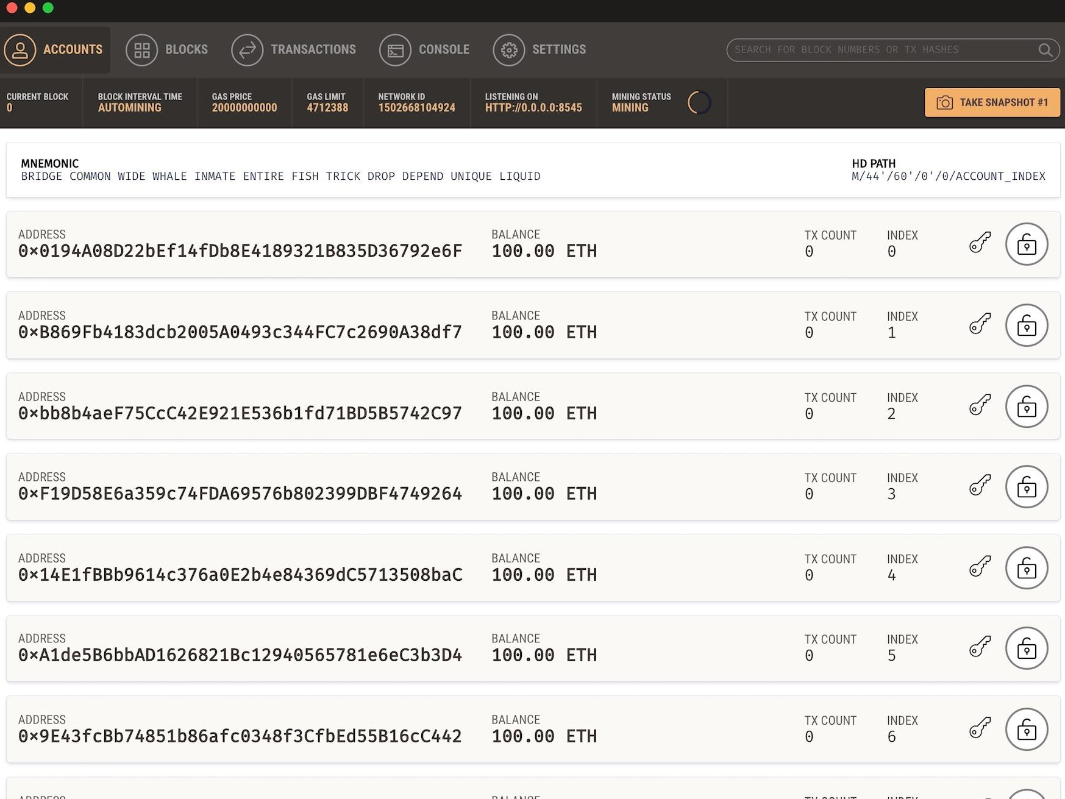

Slide 70
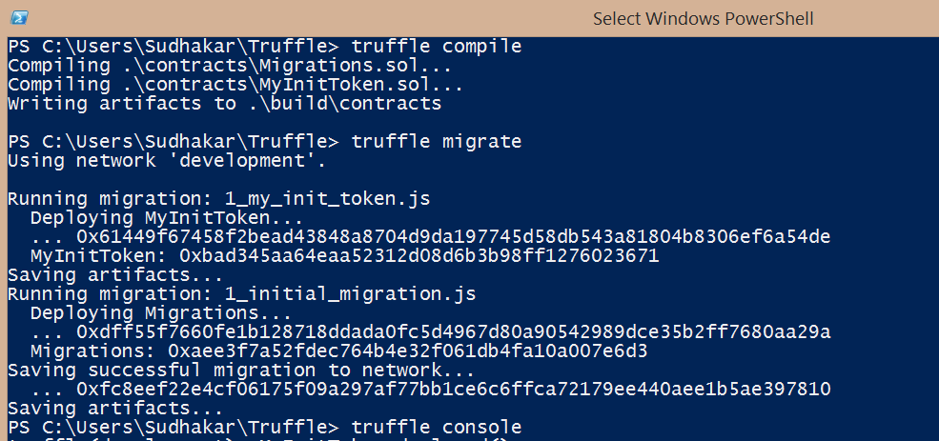
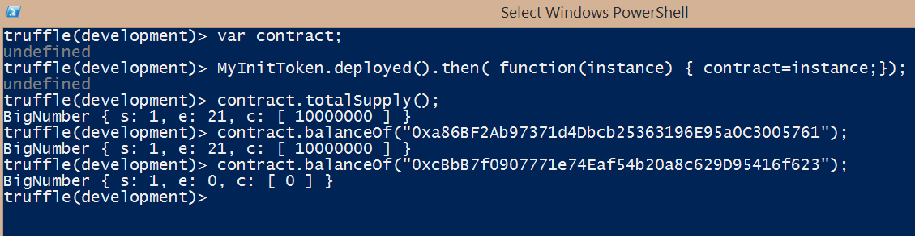

Slide 71
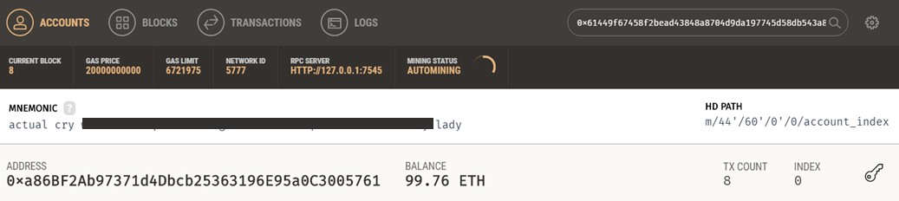
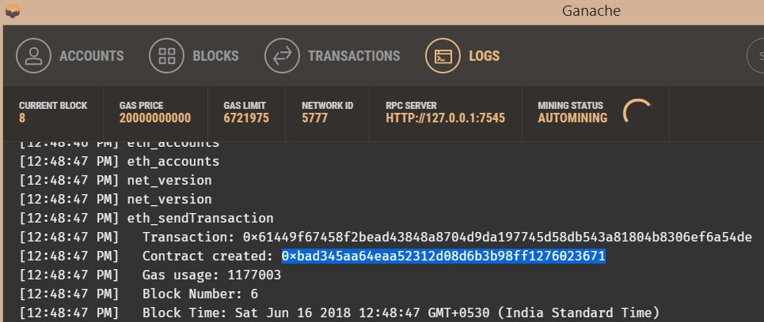
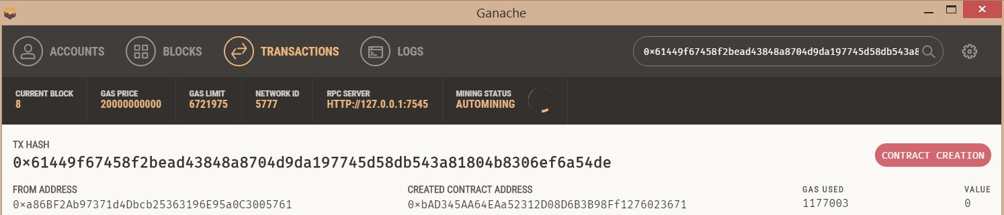

Slide 72
Truffle Commands
Truffle
truffle console
var contract
MyInitToken.deployed().then( function(instance) { contract=instance;});
contract.balanceOf("0xcBbB7f0907771e74Eaf54b20a8c629D95416f623") contract.justChecking();
Ctrl+d to come out of truffle console
Node.js
To check if node.js is installed in your system Node -v
If not installed

Slide 73
Web3.js
What is Web 3.js?
Official Ethereum JavaScript API
It supports
Managing Accounts
Signing transactions
Interaction with ethereum clients over JSON-RPC
Auto generation of java smart contract function wrappers from Solidity ABI files
https://github.com/ethereum/web3.js/

Slide 74
Web3.js
Install Web 3.js
Open windows PowerShell
Check if node.js and node package manager is installed
•
•
•
Open windows PowerShell node –v
npm –v
Create a new npm
npm init
Install web3 related libraries
npm install web3 –save
Install ethereum/web3.js
•
npm install ethereum/web3.js --save
Install Visual Studio Code
•
https://code.visualstudio.com/

Slide 75
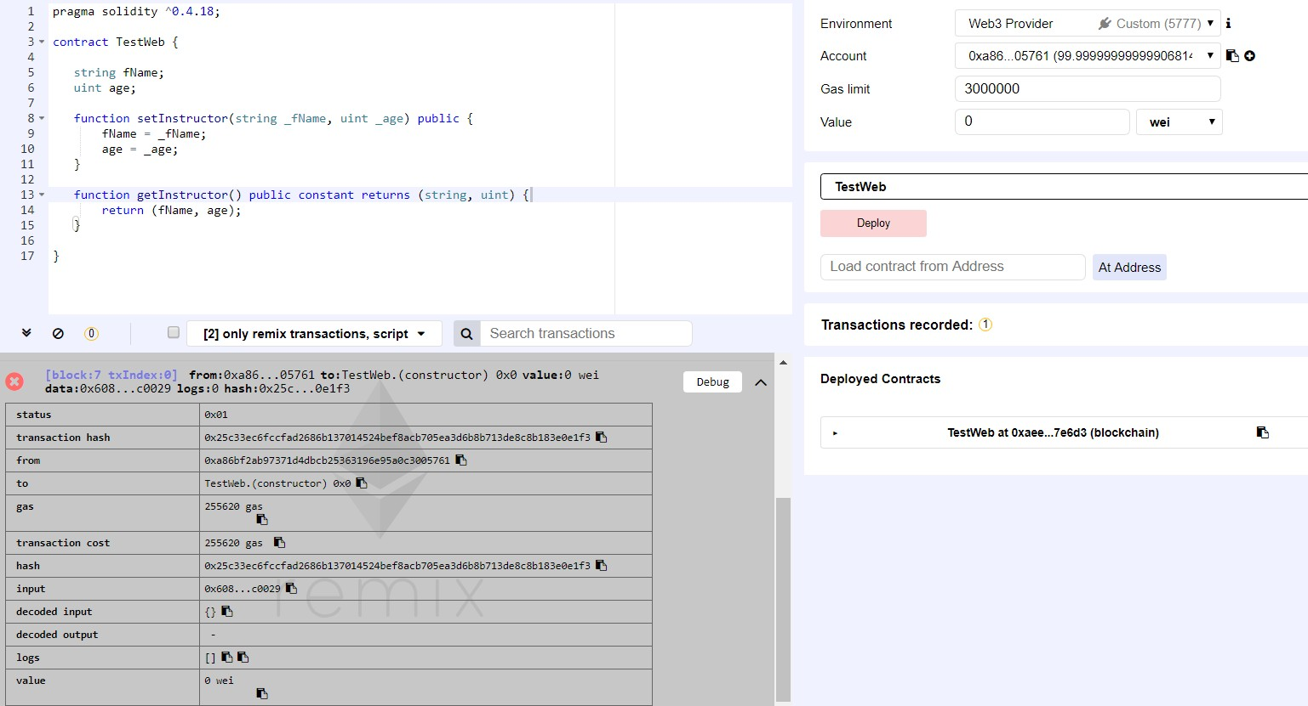
Web3.js
Create a contract TestWeb

Slide 76
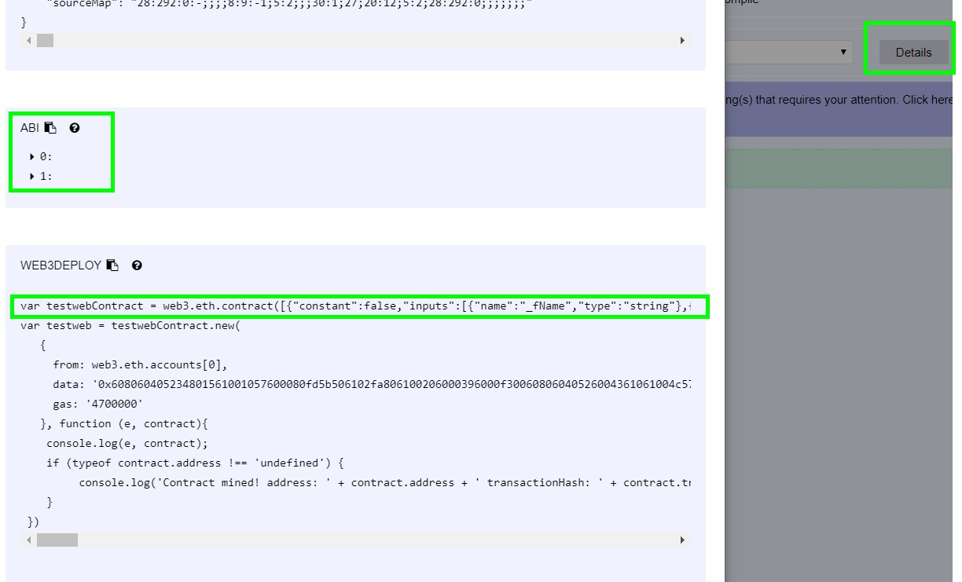
Web3.js
Get ABI and relate the contract with Web page

Slide 77
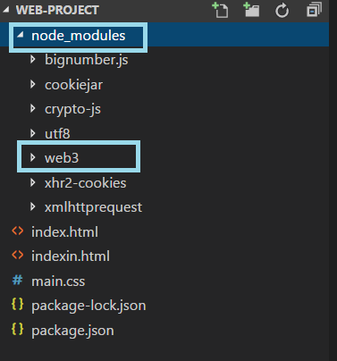
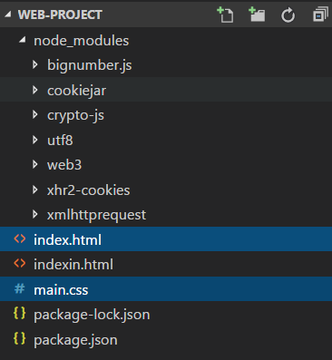
Web3.js
STEP : 1 Note the node modules folder
STEP : 2 Create the index.html and main.css file

Slide 78
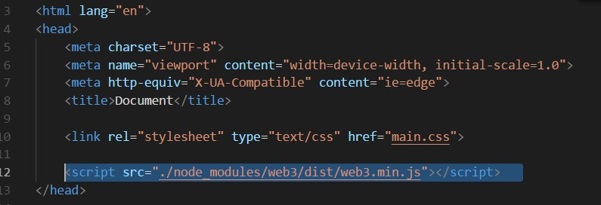
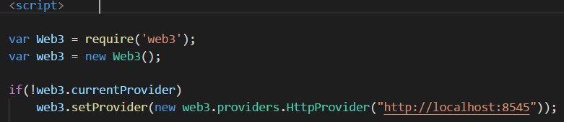
Web3.js
Add the web3 library to the page
Check if there is any content provider, else point local blockchain

Slide 79
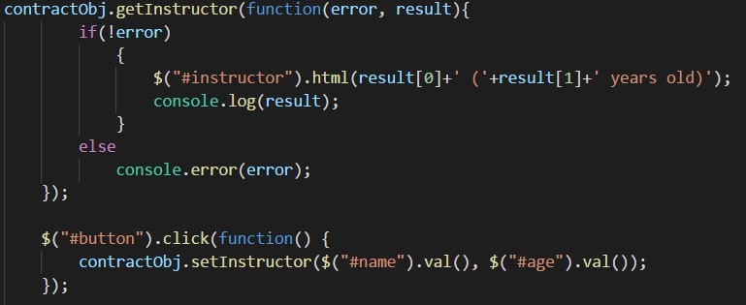
Web3.js
Get default account from your metamask
To load the contract
To interact with the contract

Slide 80
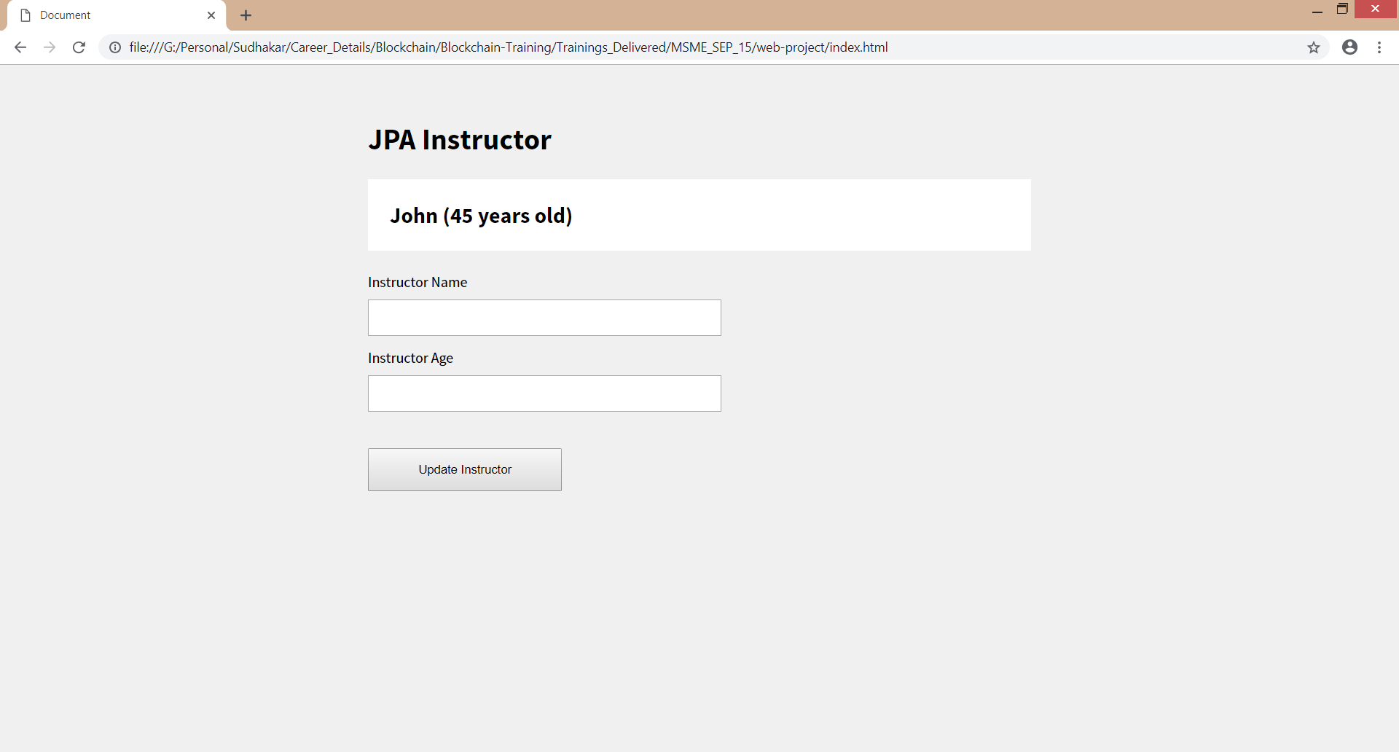
Web3.js
RUN THIS IN WIN+R
for chrome : - chrome.exe --user-data-dir="C://Chrome dev session" --disable- web-security

Slide 81
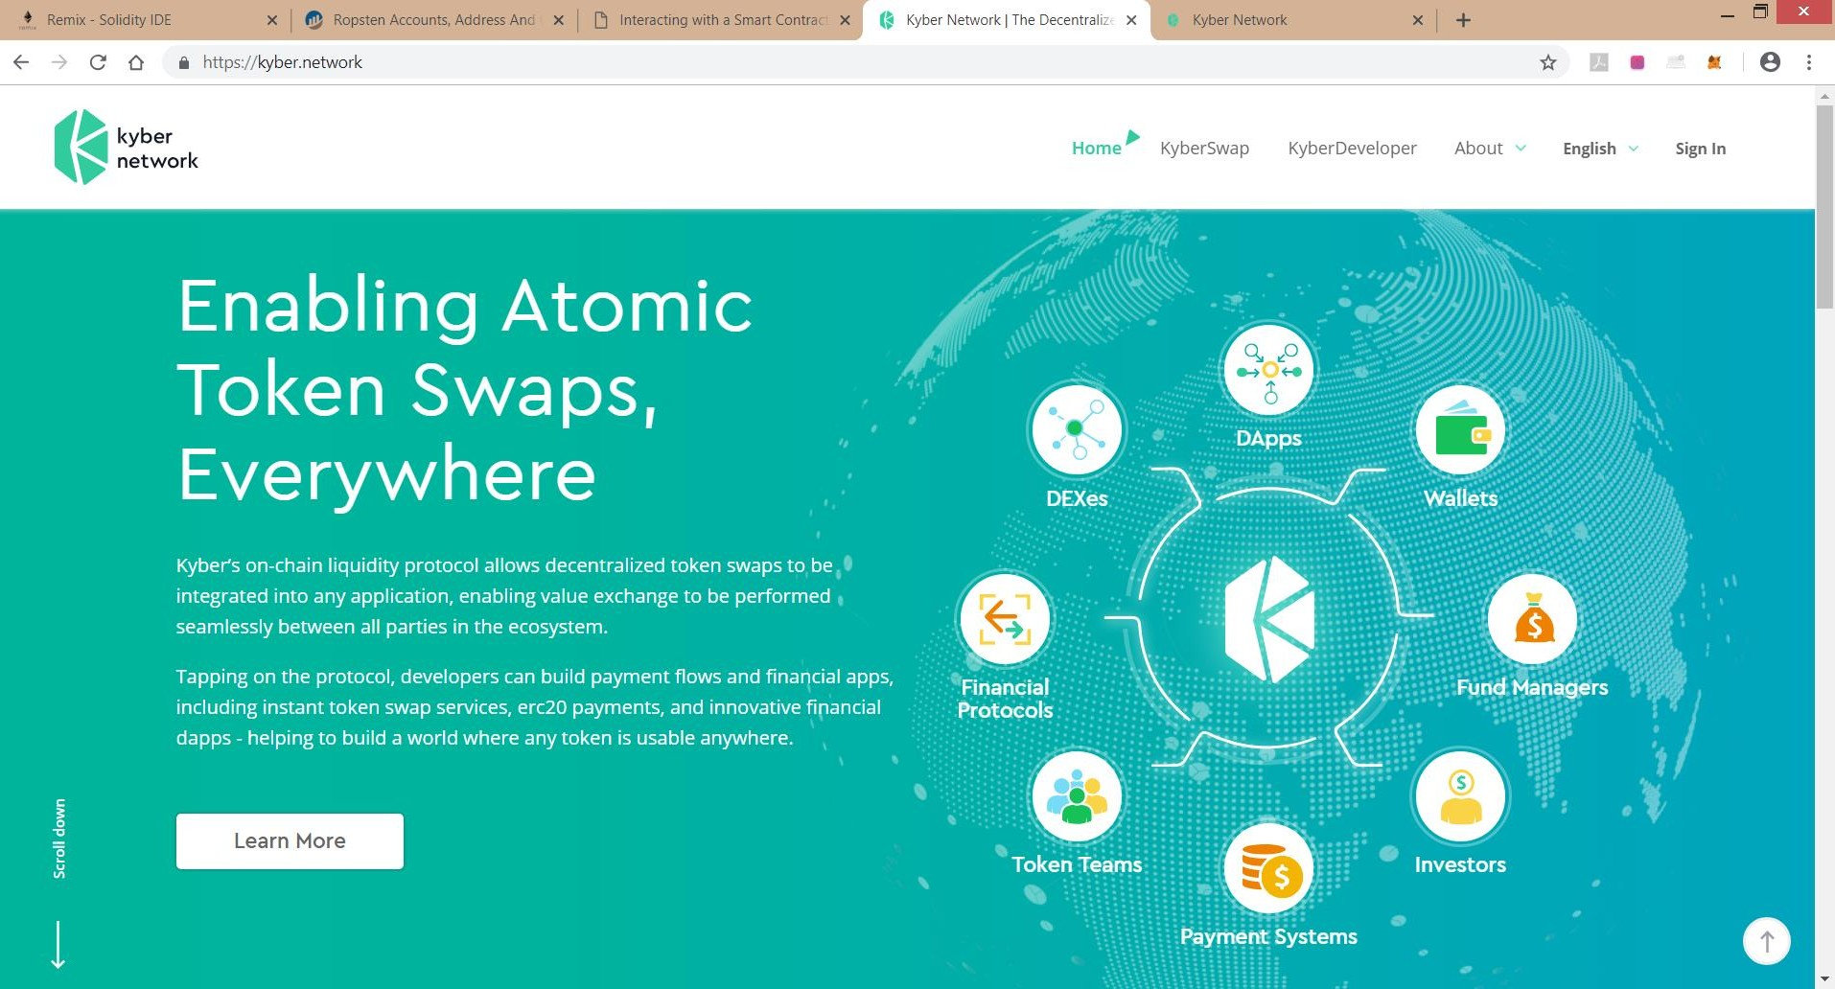
Decentralized Exchange

Slide 82
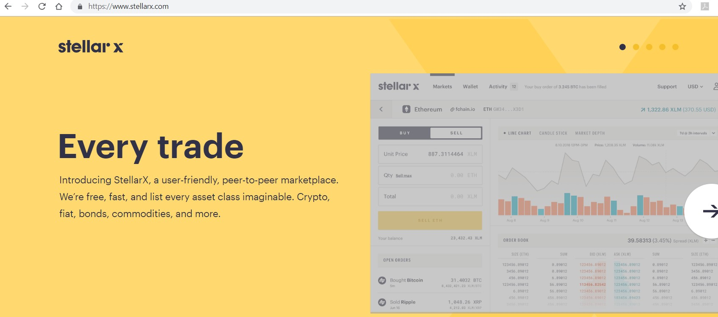
Decentralized Exchange

Slide 83


Copyright © 2017, edureka and/or its affiliates. All rights reserved.

Slide 84
Self Questionnaire
What is Airdrop ?
How ICO's are hacked ?
What is P-P exchange and decentralized exchange ? (Kyber Network)
Hot to create bitcoin paper wallet - https://walletgenerator.net/#
What if a government bans it?
Why should I not store my digital currency with a central 3rd party?
What gives cryptocurrency value?
Indian IT regulations on cryptocurrency?
Can I mine at home – Laptop / Mobile ?
Bitcoin mining calculator
https://entethalliance.org/members-2/

Slide 85

Copyright © 2017, edureka and/or its affiliates. All rights reserved.

Slide 86


